Slide 2
Luxury on Wheels: Building a Premium Brand & Cultivating Loyal Customers
Speakers:
Robyn Goldenberg
Strategy Leaders
Briana Candeub
Park Avenue Worldwide
Kelly Devlin
Premier of Dallas
Cody Belanger
Sky Coach + Limo
AV Sponsor
Coffee Sponsor

Slide 3
Welcome & Thank You to Our Sponsors
AV Sponsor
Coffee Sponsors

Slide 4
Defining Your Luxury Brand
Provide an elevated customer experience that goes above and beyond basic transportation.
Offer exclusive services and amenities to cater to discerning clientele.
Impeccable vehicles and highly professional chauffeurs are essential components of a luxury brand.
A strong brand identity and a stellar reputation are crucial for establishing a luxury brand in the limo industry.
AV Sponsor

Slide 5
Standing Out from the Competition
Identify your niche market, whether it's corporate clients, weddings, or special events, to tailor your services and branding.
Craft a unique brand story and messaging that resonates with your target audience and communicates your values.
Develop a strong visual identity that reflects your brand's personality, including a memorable logo, color palette, and font choices.
Clearly communicate your value proposition to potential clients, highlighting what sets your luxury services apart.
AV Sponsor

Slide 6
Building Credibility and Trust
Encourage satisfied clients to leave positive reviews on platforms like Google My Business and Yelp.
Respond to all online reviews promptly and professionally, demonstrating your commitment to customer satisfaction.
Actively monitor your online reputation to address any negative feedback and maintain a positive brand image.
AV Sponsor

Slide 7
Exceeding Expectations
Ensure your fleet consists of impeccable, late-model vehicles that are meticulously maintained and equipped with modern amenities.
Hire and train chauffeurs to provide professional, courteous, and discreet service with attention to detail.
Offer personalized touches, such as customized itineraries, preferred beverages, and in-vehicle entertainment, to enhance the customer experience.
Implement a seamless booking and communication process, providing prompt responses and clear confirmations to clients.
Proactively anticipate and address potential issues, going above and beyond to exceed customer expectations and create a memorable experience.
AV Sponsor

Slide 8
Engaging Premium Customers Online
Utilize high-quality photos and videos to showcase your luxurious vehicles, amenities, and the experiences you offer.
Share client testimonials and success stories to build credibility and demonstrate the value of your services.
Run targeted social media advertising campaigns to reach affluent individuals and those interested in luxury experiences.
Actively engage with your followers by responding to comments, messages, and reviews to foster relationships and build community.
AV Sponsor

Slide 9
Reaching Your Ideal Clients
Optimize your website and online content for search engines (SEO) to ensure potential clients can easily find you online.
Utilize pay-per-click (PPC) advertising to target specific keywords and demographics, driving traffic to your website.
Develop an email marketing strategy to nurture leads, share promotions, and stay top-of-mind with potential clients.
Create valuable content, such as blog posts, articles, and videos, that showcase your expertise and attract high-end clients.
Explore partnerships with complementary luxury brands and influencers to expand your reach and tap into new markets.
AV Sponsor

Slide 10
Turning Clients Into Raving Fans:
Building Long-Term Loyalty
Develop referral incentives to encourage satisfied clients to recommend your services to their friends and colleagues.
Maintain personalized communication with clients through email, phone calls, and personalized notes to show appreciation and nurture relationships.
Regularly collect and analyze customer feedback to identify areas for improvement and enhance your services to meet client needs.
AV Sponsor

Slide 11
Employees as Brand Champions:
The Power of Brand Ambassadors
Empower your employees to make decisions and take initiative to deliver exceptional customer service that reflects your brand’s values.
Provide ongoing training and development opportunities to ensure your staff is knowledgeable, skilled, and equipped to represent your brand effectively.
Implement a system for recognizing and rewarding employees who consistently go above and beyond to deliver outstanding service and uphold brand standards.
AV Sponsor

Slide 12
Emerging Trends & Tech
Adopt sustainable and eco-friendly practices, such as offering hybrid or electric vehicles, to appeal to environmentally conscious clients.
Provide personalized in-vehicle experiences, such as customized entertainment systems and curated amenities, to cater to individual preferences.
Explore the integration of AI and automation to enhance efficiency, personalize services, and optimize the customer journey.
Prioritize passenger wellness and comfort by offering features like ergonomic seating, air purification systems, and curated in-vehicle experiences.
AV Sponsor

Slide 13
Q&A Time
AV Sponsor

Slide 14
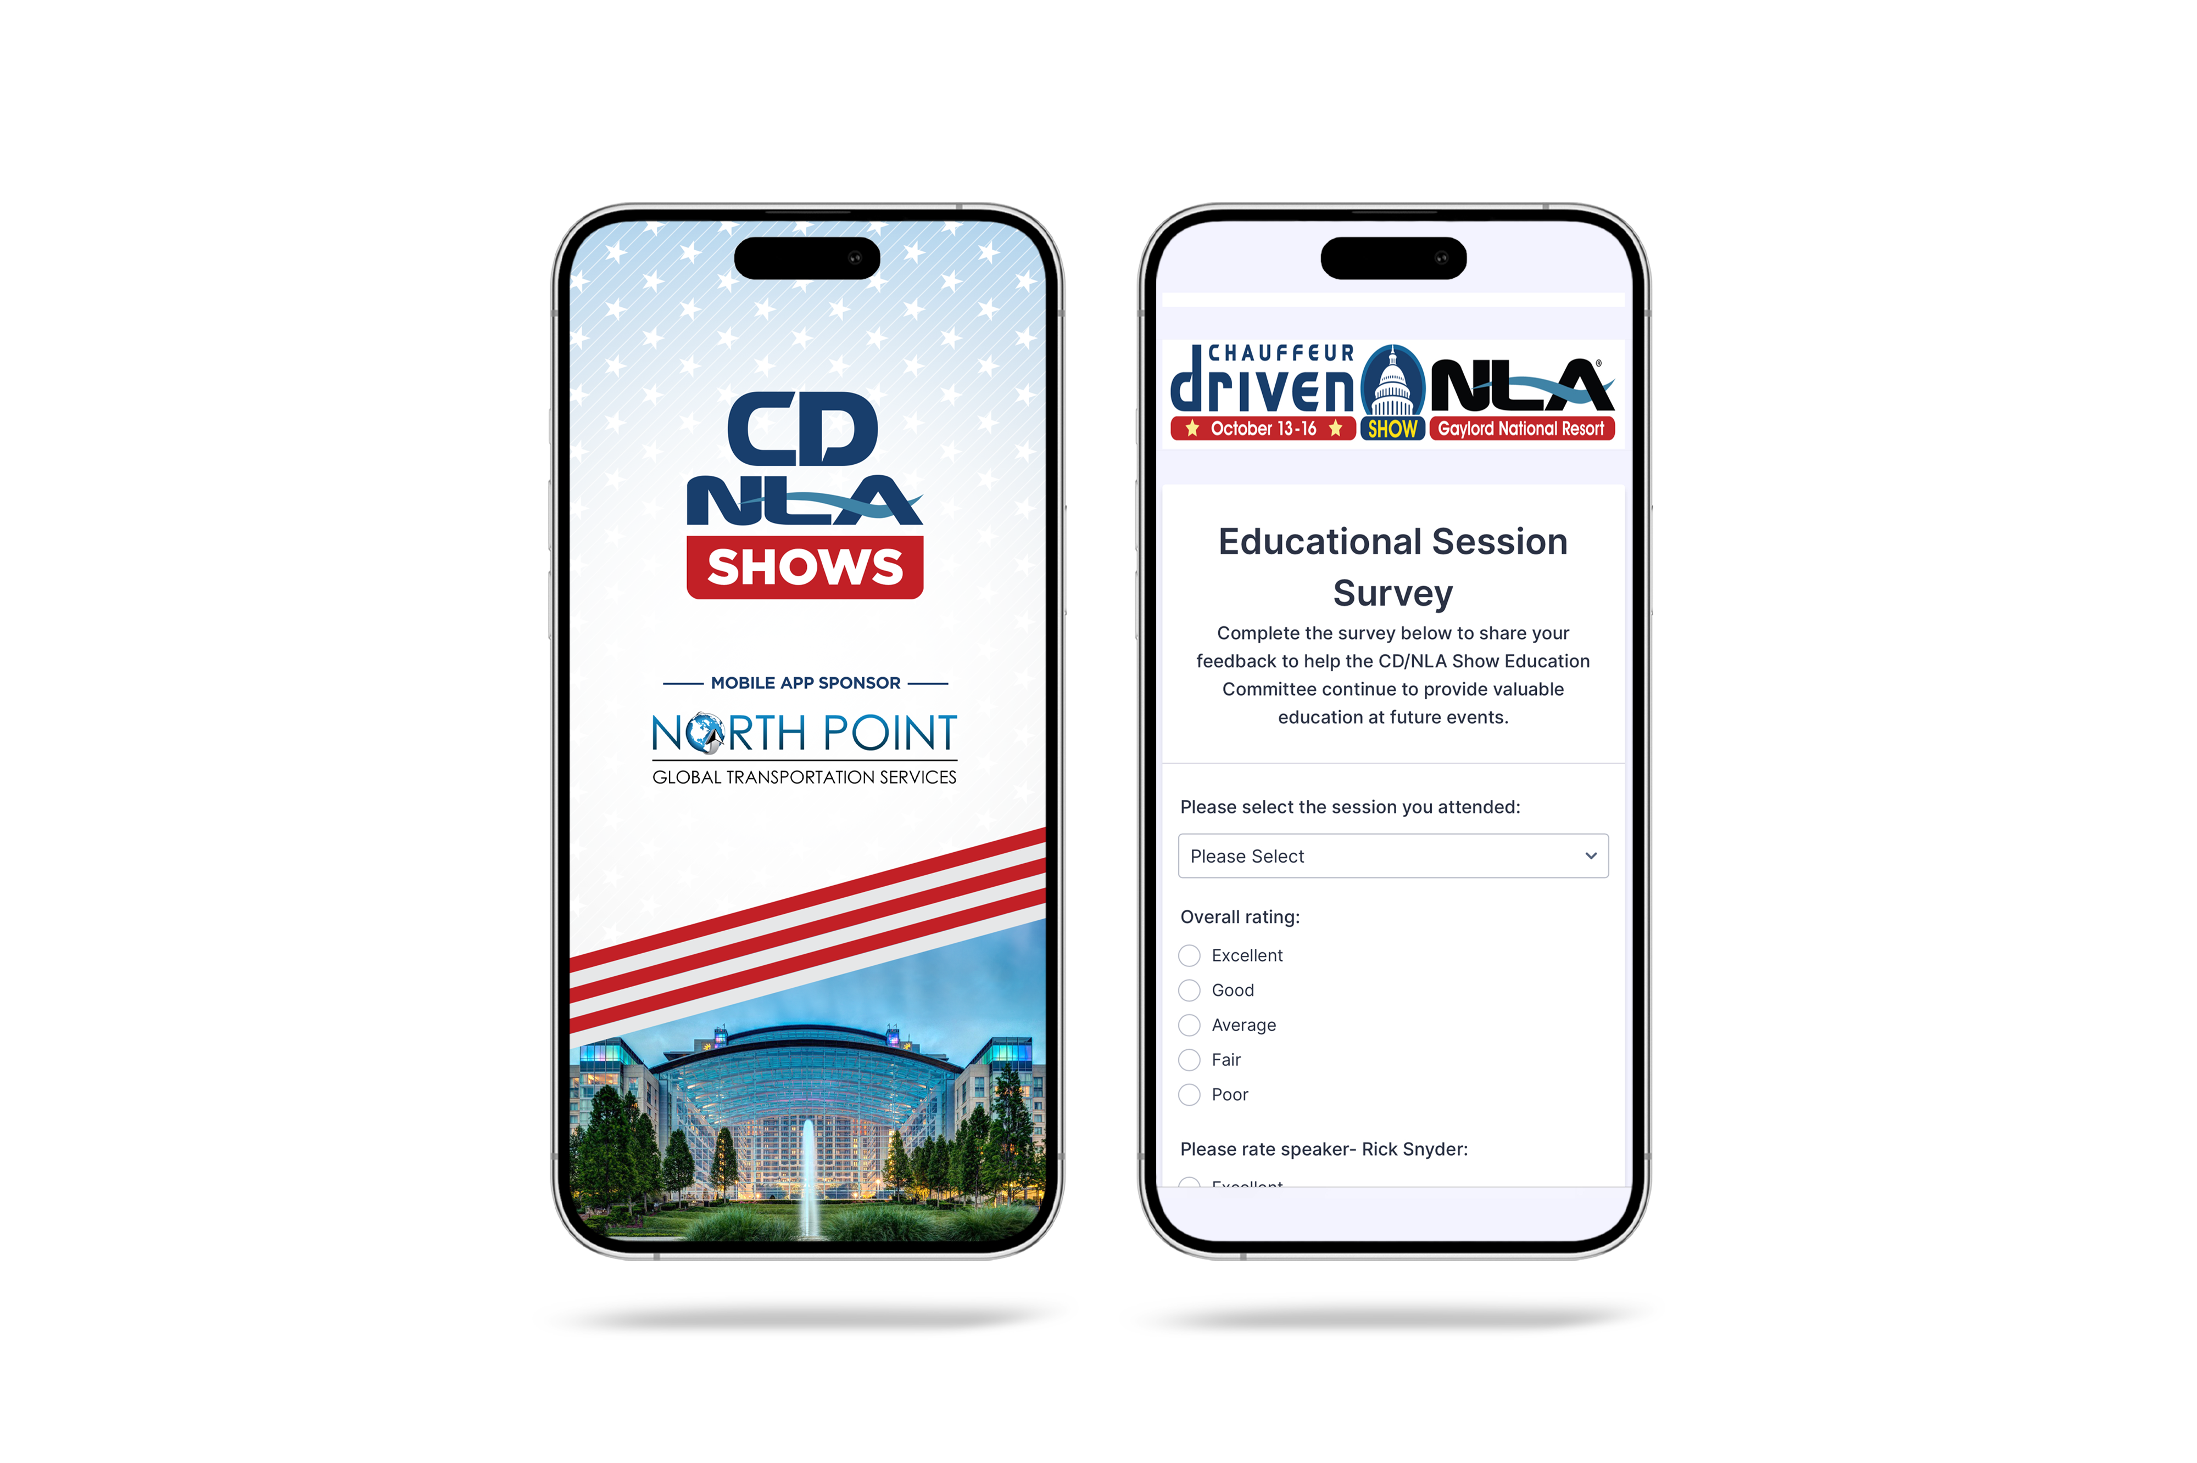
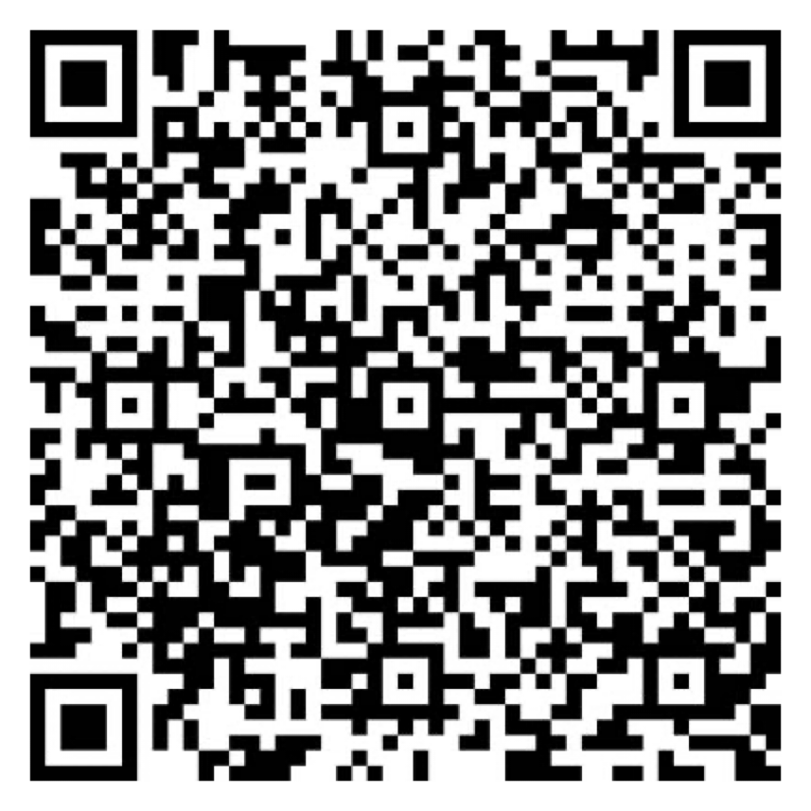
Let Us Know How
We Did!
Fill Out the Survey
AV Sponsor
Coffee Sponsor

Slide 15
Thank You for Joining Us!
AV Sponsor
Coffee Sponsor

